Slide 1
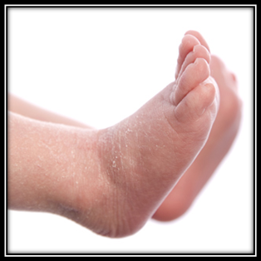
Chronological evaluation of functional changes in neonatal skin
Anushma Sharma
Peter Worsley
Howard Clark
Eugene Healy
Dan Bader
Chronological evaluation of functional
changes in neonatal skin
26 September 2017
MDVSN

Slide 2
Introduction
Hospital admissions experiencing an adverse event, defined as injuries caused by medical management are 2.9 and 3.7 percent
Deaths due to preventable adverse events exceed the deaths attributable to motor vehicle accidents, breast cancer or AIDS
To err is human-building a safer heath system. Committee on Quality of Health Care in America, Institute of Medicine 2000
Notes:
Health care is not as safe as it should be. A substantial body of evidence points to medical errors as a leading cause of death and injury.
50-60% are reported as errors or preventable events

Slide 3
1 in 8 babies born in UK will spend at least a few days in a neonatal unit for prematurity , low birth weight or have a medical condition in need for specialized treatment.
Healthcare quality improvement partnership, NDAU 2016
Notes:
3

Slide 4
1 in 8 babies born in UK will spend at least a few days in a neonatal unit for prematurity , low birth weight or have a medical condition for specialized treatment.
40% of babies admitted to neonatal unit are preterm
NDAU 2015, p4
Notes:
4

Slide 5
1 in 8 babies born in Uk will spend at least a few days in a neonatal unit for prematurity , low birth weight or have a medical condition for specialised treatment.
40% of babies admitted to neonatal unit are preterm
Skin damage is one of the most common iatrogenic injuries occurring in as many as 24% of NICU patients
Ness et at, Int J of Dermat 2013
Notes:
5

Slide 6
1 in 8 babies born in Uk will spend at least a few days in a neonatal unit for prematurity , low birth weight or have a medical condition for specialised treatment.
40% of babies admitted to neonatal unit are preterm
Skin damage is one of the most common iatrogenic injuries occurring in as many as 24% of NICU patients
Equipment and devices are implicated in more than 50% of pressure ulcers in neonates
Ness et at, Int J of Dermat 2013; Ligi et al, Lancet 2008
Notes:
6

Slide 7
Iatrogenic Complications in NICU
Low incubator temperature leading to death (1930)
Excess oxygen exposure causing retinopathy of prematurity and blindness (1940)
Excess synthetic vitamin K, sulﬁsoxazole and chloramphenicol causing kernicterus and gray baby syndrome (1950)
Intrauterine exposure to thalidomide causing limb defects (1960)
Umbilical arterial catheter, tolazoline and total parenteral nutrition (TPN) causing thrombosis, hypotension and essential fatty acid deﬁciency, respectively (1970)
Vitamin E and propylene glycol causing organ damage, hyperosmolarity and seizures (1980)
Mechanical ventilation and systemic corticosteroid administration causing bronchopulmonary dysplasia (BPD) and affecting brain growth (1990)

Slide 8
Iatrogenic events in admitted neonates: a prospective
cohort study
Ligi et al, Lancet 2008
Prospective observational cohort study in neonates
388 patients were studied during 10 436 patient days.
Voluntary, non-punitive reporting
Incidence of iatrogenic events at 25.6 per 1000 patient days.
8.8 events per 1000 patient days were preventable
7.6 events per 1000 patient days were severe
Commonly reported preventable - adverse drug events, and respiratory, vascular and skin complications.
Major risk factors: LBW, GA, Length of stay, Central line, MV, CPAP

Slide 9
Iatrogenic events in admitted neonates: a prospective
cohort study
Liggi et al, Lancet 2008
Prospective observational cohort study in neonates admitted Jan – Sep 2005, Tertiary NNU, Southern France
388 patients were studied during 10 436 patient days.
Incidence of iatrogenic events at 25.6 per 1000 patient days.
8.8 events per 1000 patient days were preventable
7.6 events per 1000 patient days were severe
Commonly reported preventable - adverse drug events, and respiratory, vascular and skin complications.
Major risk factors: LBW, GA, Length of stay, Central line, MV, CPAP

Slide 10
Pressure ulcers in hospitalized neonates-
Visscher and Taylor, Scientific reports, Nature2014
Prospective study over 2 years
741 neonatal intensive care patients
31, 643 patient days.
1.5 PU per 1000 patient days (Term 1PU/1000, Preterm 2.7PU/1000 patient days)
Device related PUs 80% (> 90% in premature infants)
Conclusion
Early detection and mitigation of device related injury are essential to prevent pressure ulcers.

Slide 11
Complications of NIV- comprehensive review of randomised trials
British Journal of Anaesthesia, 2013
Excluded <18year old
RESULTS
Inability to relieve dyspnoea and improve gas exchange most important evidence of NIV failure
Careful patient selection-Important
Major complications:
Failure of NIV
Pneumonia
Barotrauma
Hypotension

Slide 12
Complications of NIV- comprehensive review of randomised trials
Minor complications
Problem | Incidence (%)
Arm oedema | <5
Co2 rebreathing | 50-100
Claustrophobia | 5-20
Discomfort | 30-50
Nasal skin lesion | 5-50
Noise | 50-100
Patient –ventilator dysynchrony | 13-100
Notes:
12

Slide 13
Complications of NIV- comprehensive review of randomised trials
Minor complications
Problem | Incidence (%) | Relevance to NICU
Arm oedema | <5 | x
Co2 rebreathing | 50-100 | x
Claustrophobia | 5-20 | √
Discomfort | 30-50 | √
Nasal skin lesion | 5-50 | √
Noise | 50-100 | √
Patient –ventilator dysynchrony | 13-100 | √
Notes:
13

Slide 14
National pressure ulcer advisory panel-White paper
2007
Pressure ulcers in neonates and children
Most ulcers occur within 2 days of admission
Incidence higher with HFOV than conventional
53% vs 12.5%
However PICU length of stay more statistically significant than ventilation type
 | Prevalence
PICU | 27%
NICU | 20%
Non critical paediatric patients | 0.5-13%

Slide 15
National pressure ulcer advisory panel-White paper
2007
Pressure ulcers in neonates and children
Risk factors
Products for adults may not be suitable to use for children and neonates
Alterations in the tissue integrity of neonatal and pediatric patients can
result in pain, infection, mortality, higher care costs, increased hospitalization and
increased litigation.
Suggestion: evidenced-linked neonatal and pediatric pressure ulcer
prevention and treatment guideline could evolve

Slide 16
Face masks for non-invasive ventilation
Visscher et al
Respiratory care Nov 2015
Prospective cohort study
50 subjects using face masks for noninvasive ventilation.
Imaging, hydration measurements, 3 interventions to reduce trauma
Results
Reduced skin breakdown with best fit masks and maintenance of normal skin hydration

Slide 17
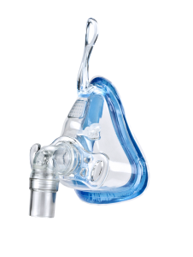
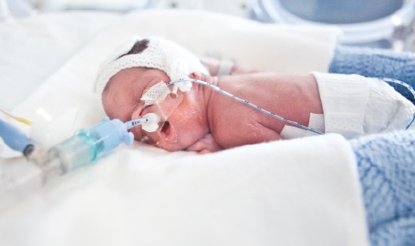
Why do Devices cause skin damage
Generic designs incorporating traditional stiff polymer materials
Little guidance for application resulting in high tension against the skin surface
Frequently used by individuals who have multiple co-morbidities
17

Slide 18
Structure and Function of Skin
Skin Characteristic | Adult | Term | Pre-term | Relevance to Skin Health
Epidermal Thickness | 50µm | 50µm | 27.4µm | ↑Transepidermal water loss
Cell attachments | Normal | Normal | Fewer | ↑Tendency to blister
Dermis | Normal | ↓Collagen and elastic fibers | ↓↓Collagen and elastic fibers | ↓Elasticity ↑Blistering
Eccrine glands | Normal | ↓Activity for 7–10 days | Total anhidrosis | ↓Response to thermal stress
Vernix caseosa | NA | Fully developed | Undeveloped or absent | ↓hydration, ↓bacterial protection
Acid mantle | Normal | Normal | delayed | ↓antimicrobial processing
Table 1 Structural and functional differences of adult, term, and preterm infant skin

Slide 19
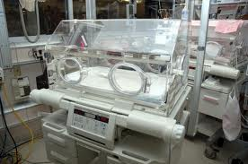
Skin Development and the Environment
Neonatal skin undergoes substantial adaptations from water based alkaline environment to a dry gaseous environment.
Preterm skin characteristics will inevitably influence their ability to control body temperature and water balance.
Humidified incubators are used to decrease evaporative losses and thermal instability.
  Increased barrier formation when subjected to a lower RH.
  An enclosed environment with a high RH can pose a risk for nosocomial infection.
There is no established consensus on the optimal level of humidification for preterm infants.

Slide 20
Chronological evaluation of functional changes in neonatal skin
Chronological evaluation of functional
changes in neonatal skin

Slide 21
AIMS
Evaluate the interaction between the environment and skin development in preterm infants
Develop a series of robust parameters which assess the integrity of the skin in neonates
Establish the relationship between gestation age and the development of skin function

Slide 22
Inclusion criteria
All preterm babies
All term babies
Exclusion criteria
Infants with dermatological conditions (e.g. collodion skin, harlequin baby)
Infants receiving therapeutic hypothermia

Slide 23
Data collection
GA↓/Time→ Investigations↓ |  | Birth/ Consent | <48hours | 3-4 days | 6-7 days | 9-11 days | 13-15 days | 28-34 days | 50-56 days or before discharge
Preterm |  | √
 | pH |  | √ | √ | √ | √ | √ | √ | √
 | TEWL |  | √ | √ | √ | √ | √ | √ | √
 | USS skin |  | √ | √ | √ | √ | √ | √ | √
 | Biofluid Swab |  | √ | √ | √ | √ | √ | √ | √
Term |  | √
 | pH |  | √ |  | √
 | TEWL |  | √ |  | √
 | USS skin |  | √ |  | √

Slide 24
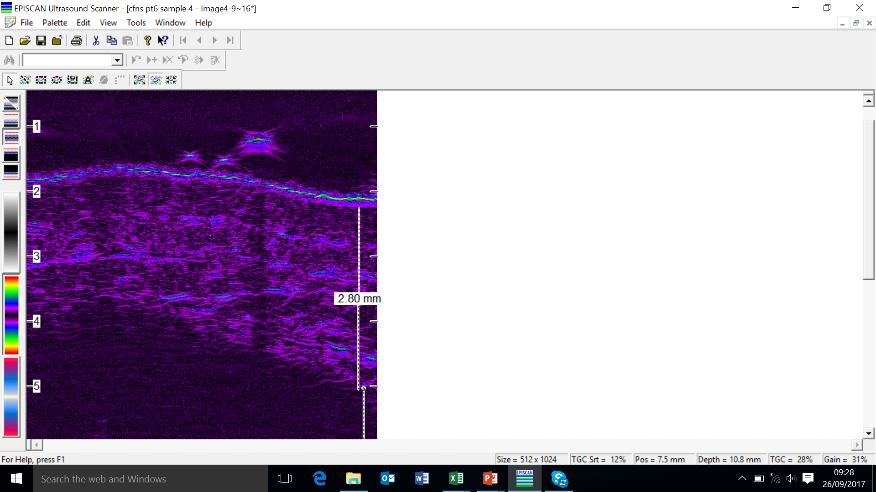

Measurements
TEWL
pH
Thickness of the skin ucing high frequency US

Slide 25
Till date……………….
11 term
20 preterm
24+5 to 36+6 weeks
690-2725g

Slide 26
Three subjects…
 | GA | Weight (g) | Weight centile | No. of readings |  | Antenatal steroids | Mode of delivery
1 | 33 | 980 | 0.4th centile | 7 | F | √ | LSCS
2 | 24+5 | 730 | 50th centile | 7 | F | √ | LSCS
3 | 24+5 | 800 | 25-50th centile | 6 | M | √ | LSCS

Slide 27
Subject 1
Time | 26h | Day 4 | Day 7 | Day 11 | Day 15 | Day 30 | Day 48
TEWL | 12.6-18.6 | 14.3-21.6 | 8.3-9.2 | 4.1-9.6 | 7.9-13.2 | 11.4-22.6 | 14.4-16.7
pH | 6.6 | 6.2 | 5.66 | 6 | 5.8 | 5.6 | 5.5
Dermis | 1.13 | 1.15 | 1.27 | 2.8 | 1.87 | 1.53 | 1.43
Hypo dermis | 4 | 3.66 | 4.05 | 4.42 | 3.58 | 3.71 | 4.09

Slide 28
Subject 2 and 3
 | F | M | F |  | M | F | M | F | M | F | M | F | M | F | M
Time | 42h | 41h | Day 4 |  |  | Day 7 |  | Day 10 |  | Day 16 |  | Day 31 |  | Day 45
TEWL | 27 | 26 | 20 | 22 |  | 15 | 15 | 10 | 17 | 19 | 14 | 23 | 15 | 21
pH | 6.4 | 5.8 | 6.3 | 6.6 |  | 6.1 | 6.3 | 5.9 | 6.3 | 6.0 | 5.9 | 5.8 | 6.0 | 6.3
Dermis | 0.9 | 1.0 | 1.1 | 1.2 |  | 1.2 | 1.3 | 1.4 | 1.4 | 1.4 | 1.5 | 1.53 | 1.53 | 1.58
Hypo dermis | 3.4 | 2.2 | 3.5 | 2.2 |  | 3.4 | 3.1 | 3.5 | 3.2 | 4.1 | 3.3 | 4.95 | 3.32 | 4.82

Slide 30
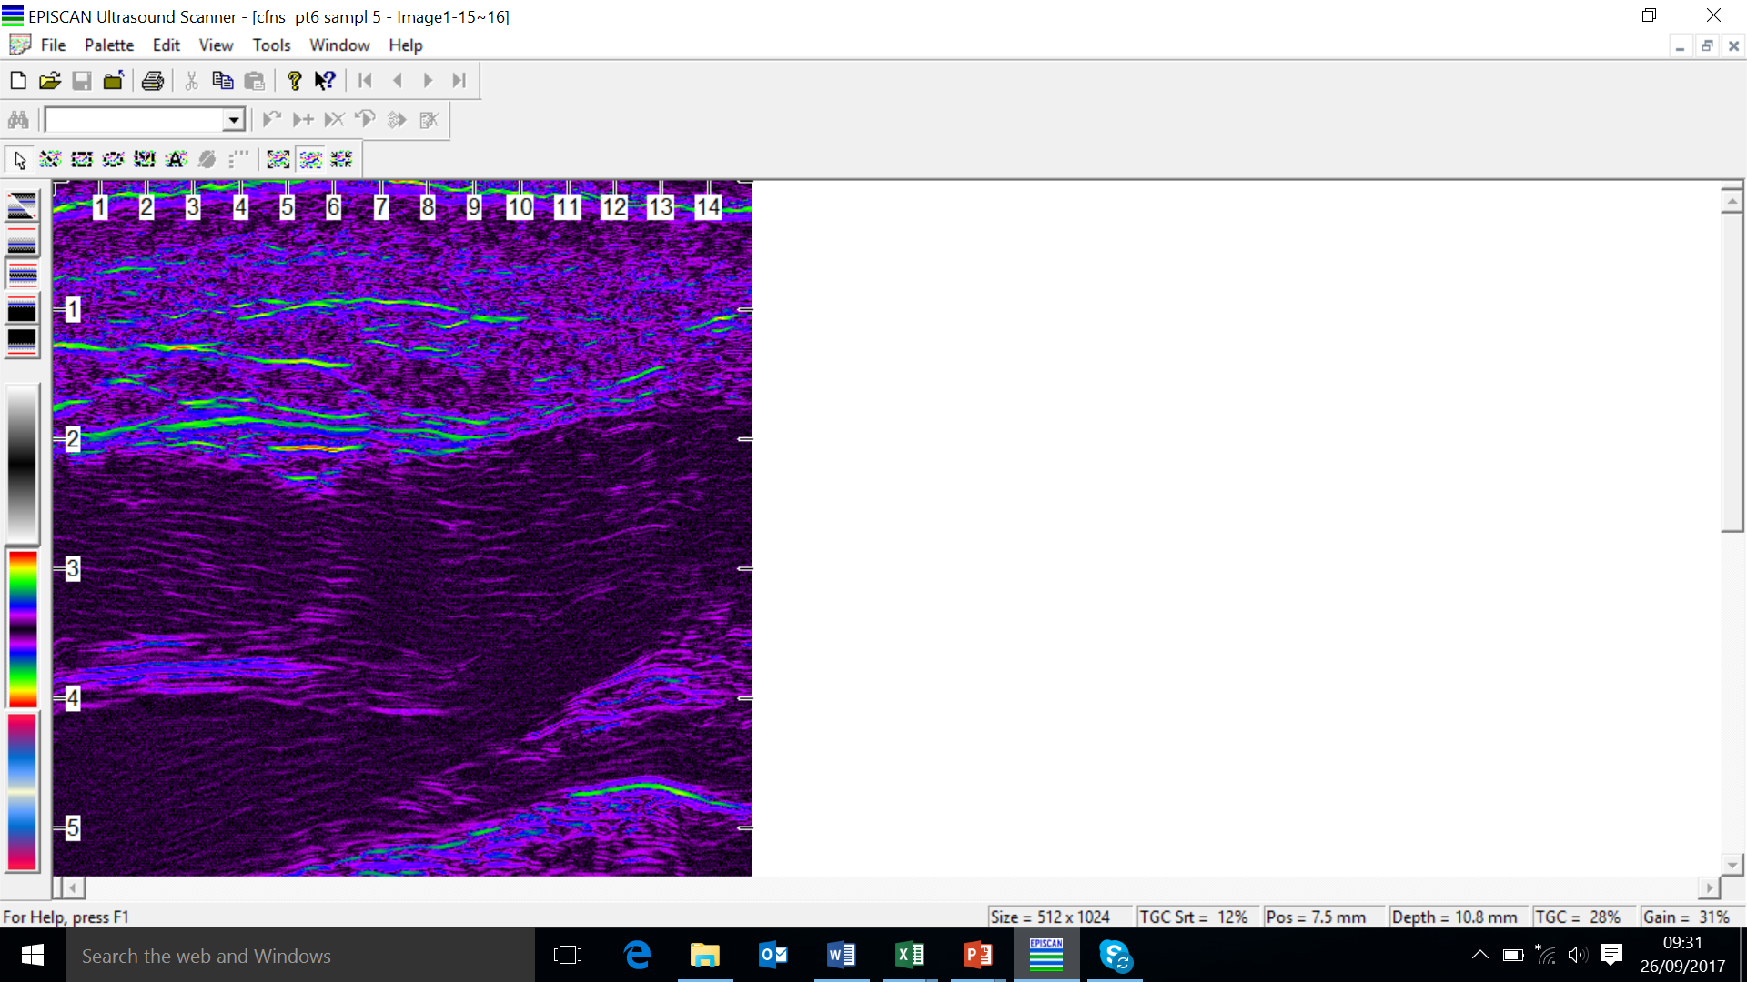

Slide 31
24+5
24+5 | 3
26+6
27+0
27+4
28+0 | 6
29+0
29+1
29+1
31+4 | 3
31+6
32+6
33+0 | 4
33+0
34+2
34+3
35+2 | 4
35+5
35+5
36+6
690
730
790
790
800
870
980
1080
1275
1475
1725
1750
2000
2120
2235
2355
2370
2443
2700
2725
F=9, M=11
3 East Europeans, 1 Afro-caribbean, 16 white-british
6 vaginal, 1 forceps, 13 LSCS
All but 2 had antenatal steroids
9 had plastic bag

Slide 32
 |  |  | GA at birth | weight g |  | Antenatal steroids | delivery
 |  |  |  |  |  | yes | LSCS
CFNS PT6 |  |  | 33+0 | 980 At 3rd standard deviation/0.4th cent
CFNS PT4 |  |  | 24+5 | 730 just below the 50th centile |  | yes | LSCS
CFNS P15 |  |  | 24+5 | 800 25-50th centile |  | yes | lLSCS

Slide 34
Watch this space……..

